Slide 1
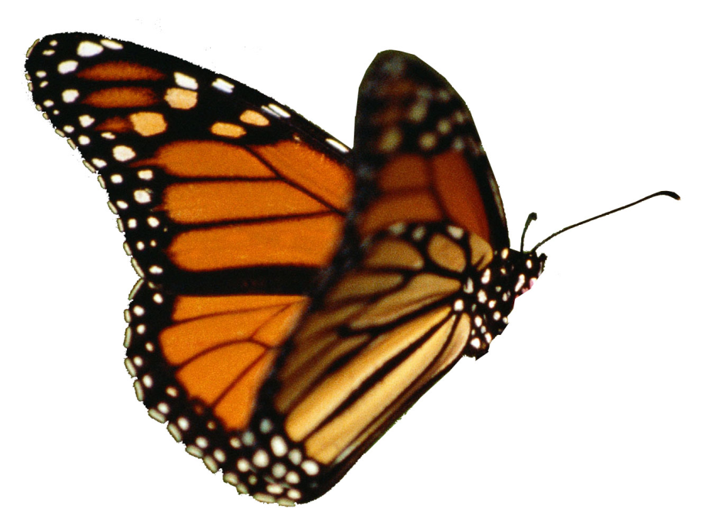
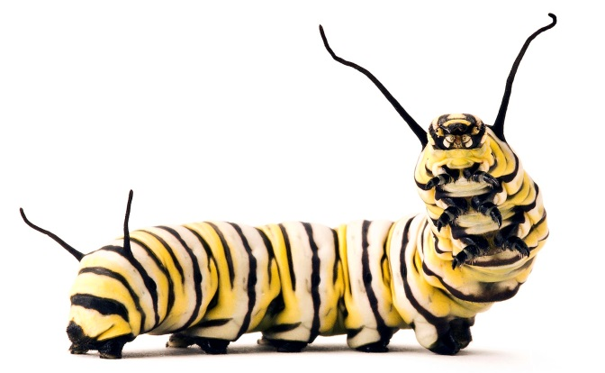
The Life Cycle of a Butterfly
Notes:
http://3.bp.blogspot.com/_Tx1p9FGFNmw/TUkW4434JTI/AAAAAAAAAEk/uCcZQi-XIGU/s1600/butterfly-nolegs-2+yellow+flying.jpg
http://parentables.howstuffworks.com/slideshows/family-matters/curious-critters-book-candy-kids-eyes-and-brains/

Slide 2
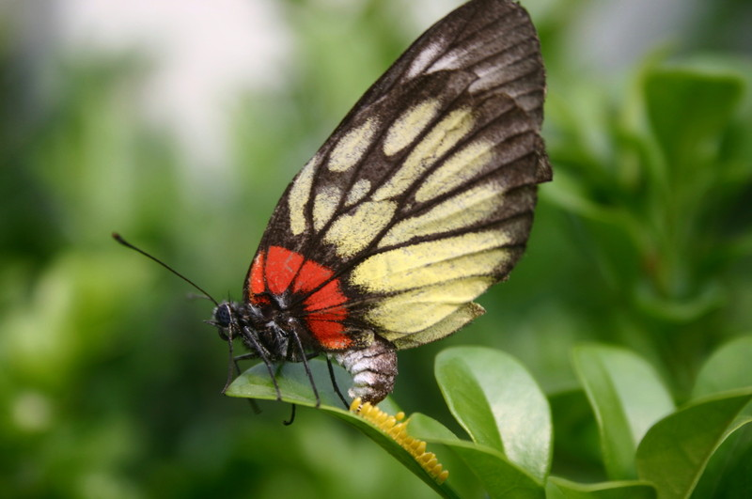
The mummy butterfly lays some eggs on a leaf or stem of a plant. This is so that when the little caterpillars hatch, they will be able to eat the plant.
Notes:
http://icons.wunderground.com/data/wximagenew/s/scottinchina/0-800.jpg

Slide 3
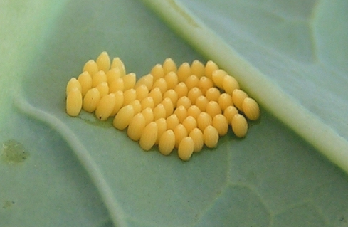
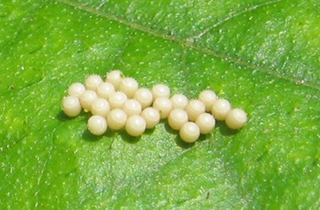
These are some butterfly eggs. They are really really small.
Notes:
http://ed101.bu.edu/StudentDoc/Archives/ED101sp10/brettw1/Images/dartmoor_days_out-_1_16.jpg
http://ventnorpermaculture.files.wordpress.com/2008/07/large_white_eggs.jpg

Slide 4
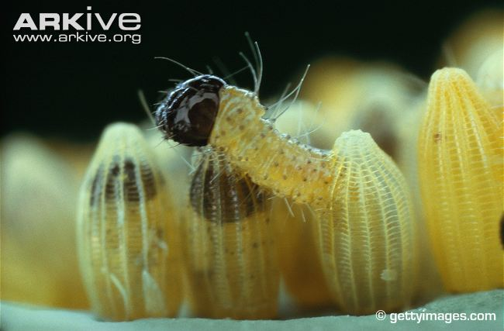
The caterpillars are hatching!
Notes:
http://cdn1.arkive.org/media/04/046CCA85-8F16-4BE6-B747-4DF02BBB8015/Presentation.Large/Large-white-caterpillar-hatching-from-egg.jpg

Slide 5
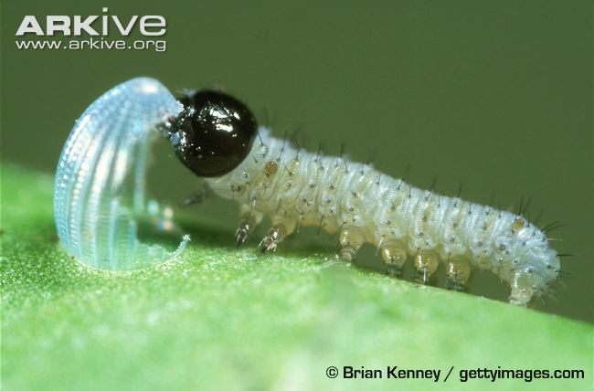
The egg shell is the first food the little caterpillars eat!
Notes:
http://www.arkive.org/monarch-butterfly/danaus-plexippus/image-G54353.html

Slide 6
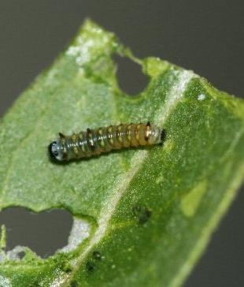
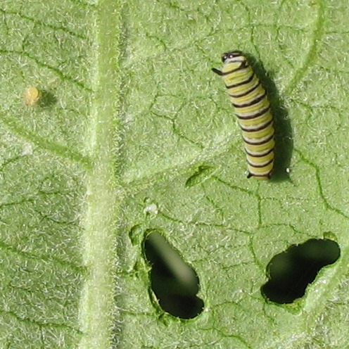
As the caterpillar grows, its body changes a lot.
Notes:
http://www.raisingbutterflies.org/the-queen/single-gallery/7128582
http://commons.wikimedia.org/wiki/File:Monarch_caterpillar_and_egg.jpg

Slide 7
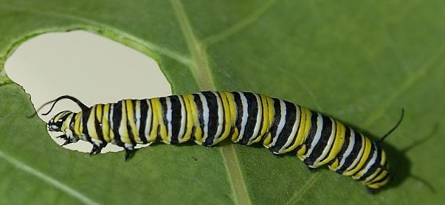
The caterpillar needs to eat and eat so that it can grow quickly.
Notes:
http://bybio.wordpress.com/2012/06/
http://lansingwbu.blogspot.co.uk/2013_05_01_archive.html

Slide 8
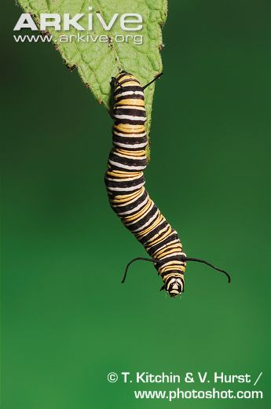
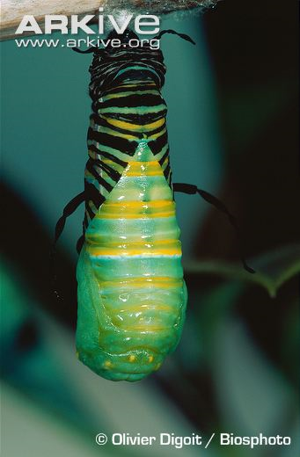
When the caterpillar has eaten enough, it hangs upside down and is makes a chrysalis.
Notes:
http://bybio.wordpress.com/2012/06/

Slide 9
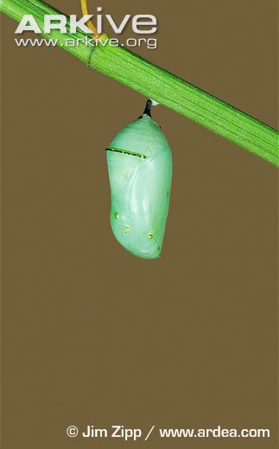
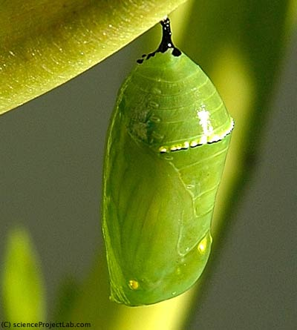
A chrysalis is a shell. The caterpillar will make its big change into a butterfly in the chrysalis. The chrysalis is hard so that it protects the caterpillar, and is green to help hide it from other animals that might want to eat it.

Slide 10
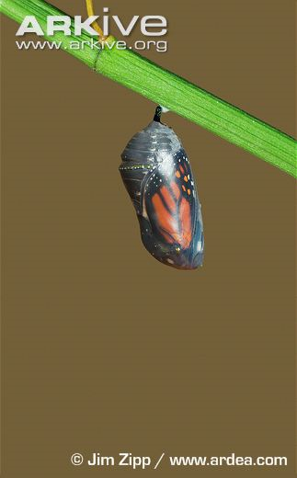
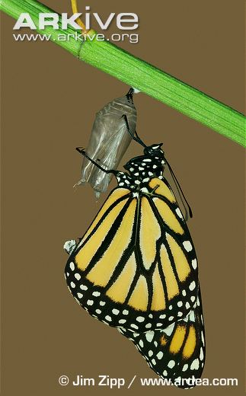
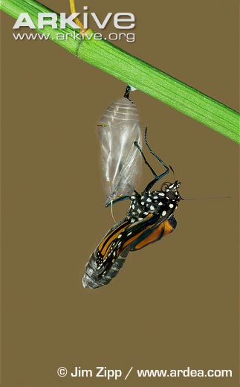
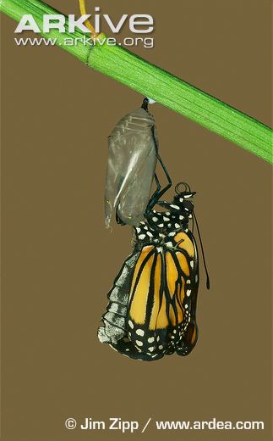
When the caterpillar changes into a butterfly, we call it a metamorphosis.

Slide 11
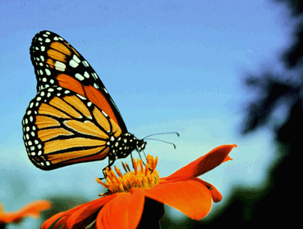
The butterfly drinks the nectar from flowers.
Notes:
http://monarch-butterfly.info/Species.html

Slide 12
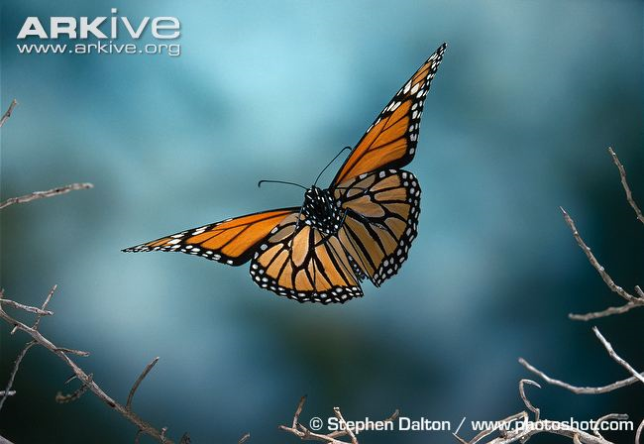
When the butterfly is ready, it will find another butterfly so that they can make some eggs.

Slide 13
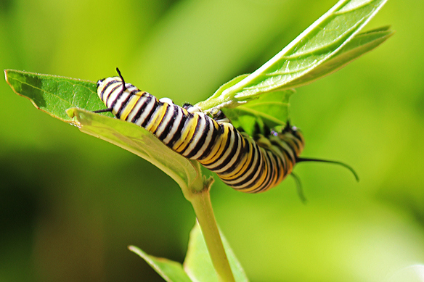
Summary: Butterfly Life Cycle

