Slide 1
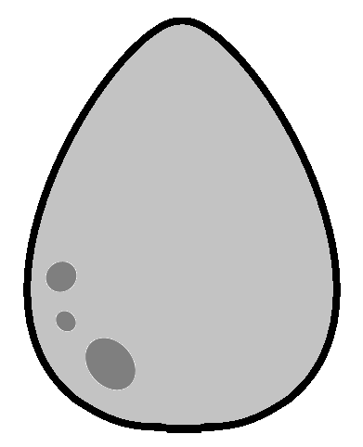
Egg or no egg?

Slide 2
Notes:
If you think the animals hatches from an egg, then have your thumbs up, or else thumbs down.

Slide 3
Notes:
Free snake image from: http://animals.phillipmartin.info/animal_snake.htm

Slide 5
Notes:
Free snake image from: http://animals.phillipmartin.info/animal_snake.htm

Slide 6
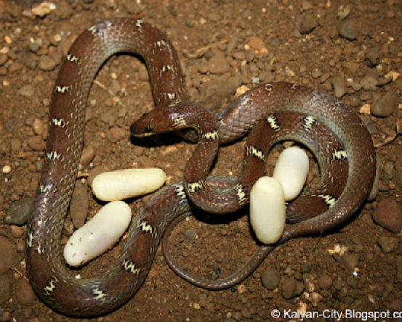
Notes:
Image from: http://kalyan-city.blogspot.co.uk/2010/07/common-wolf-snake-lycodon-aulicus.html

Slide 7
Notes:
Image from: http://bestclipartblog.com/12-pig-clipart.html/pig-clipart-7

Slide 9
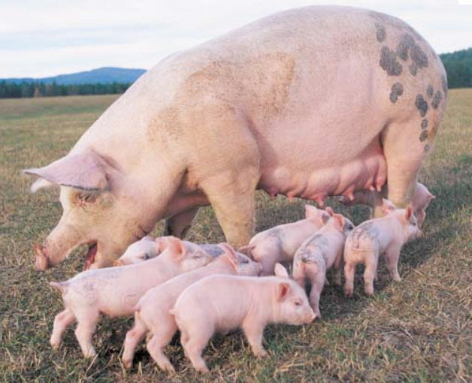
Notes:
Image from: http://www.britannica.com/EBchecked/media/70034/Female-pigs-can-have-as-many-as-20-piglets-in

Slide 13
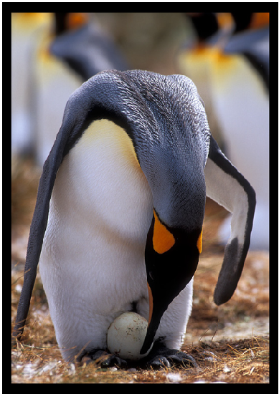
Notes:
Image from: http://www.penguin-pictures.net/kingpenguinegg.jpg

Slide 16
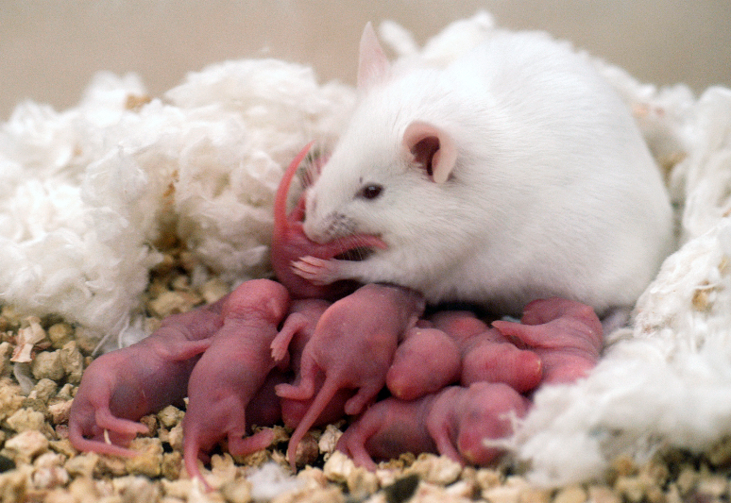

Slide 17
Notes:
Image from: http://www.dailyclipart.net/clipart/category/animal-clip-art/page/11/

Slide 20
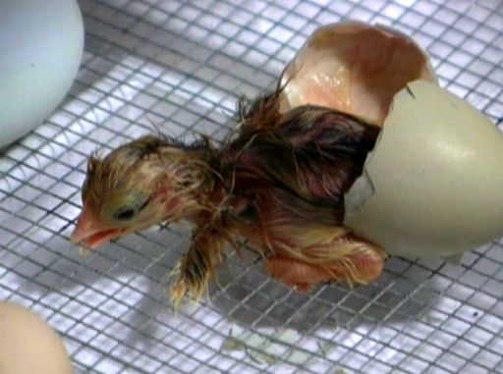
Notes:
Image from: http://edenparadigm.com/tag/hatching-chicken-eggs

Slide 23
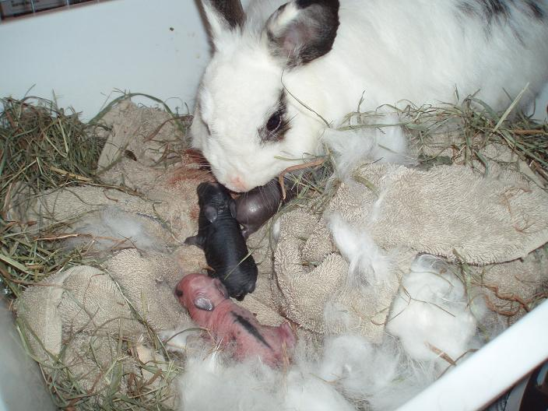

Slide 24
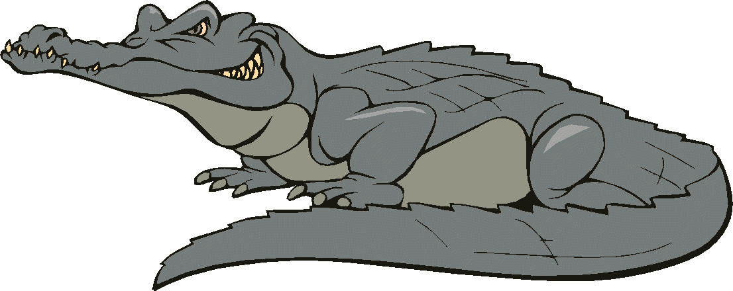
Notes:
Image from: http://www.arthursclipart.org/crocodiles/crocodiles/page_01.htm

Slide 27
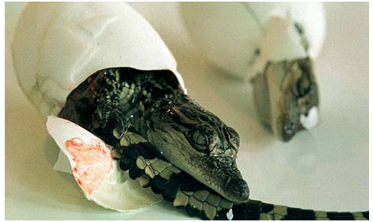
Notes:
Image from: http://www.guardian.co.uk/science/2008/jun/24/animalbehaviour.wildlife

Slide 28
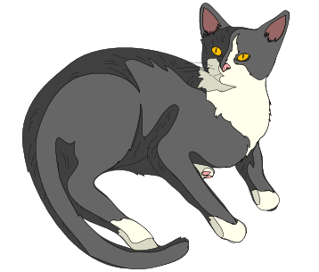

Slide 30
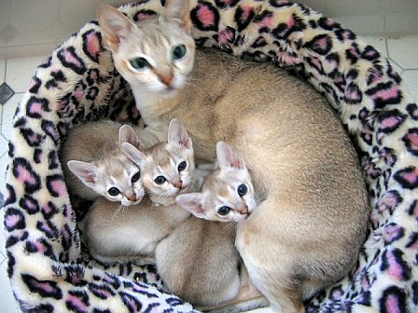
Notes:
Image from: http://catbed.com.au/wp-content/uploads/2011/04/Singapura-cat.jpg

Slide 33
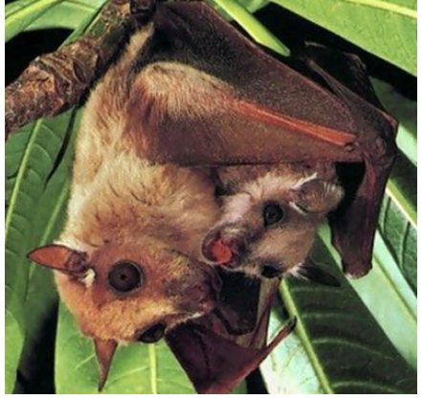
Notes:
Image from: http://topnews.net.nz/content/217482-government-s-plea-culling-fruit-bats

Slide 34
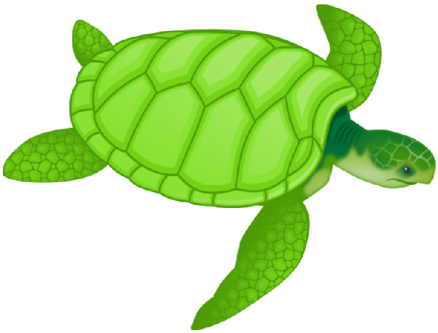
Notes:
Image from: http://bestclipartblog.com/7-turtle-clip-art.html/turtle-clip-art-1

Slide 37
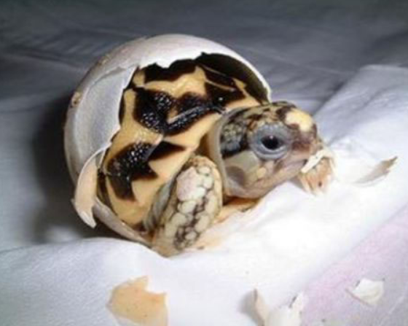
Notes:
Image from: http://www.hemmy.net/2008/05/27/birth-of-a-turtle/

Slide 38
The end
Notes:
Image from: http://www.hemmy.net/2008/05/27/birth-of-a-turtle/

