Slide 1
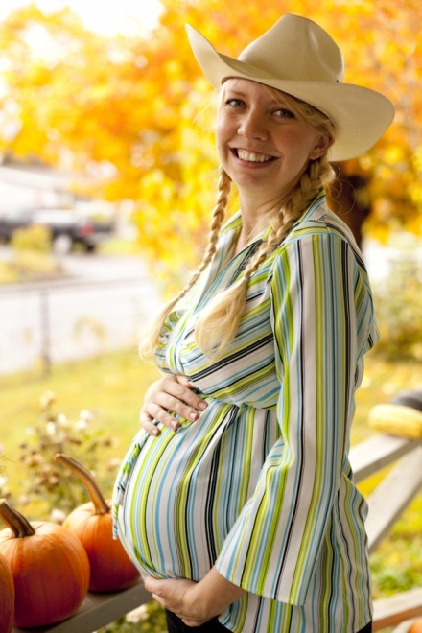
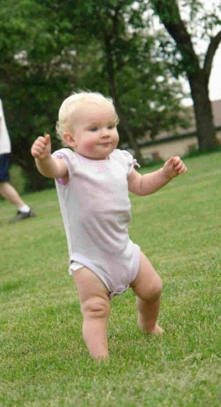
Human Life Cycle

Slide 2
A baby is growing inside the mummy’s tummy. The baby grows in its mummy’s tummy for 9 months.

Slide 3
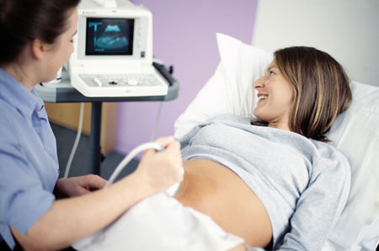
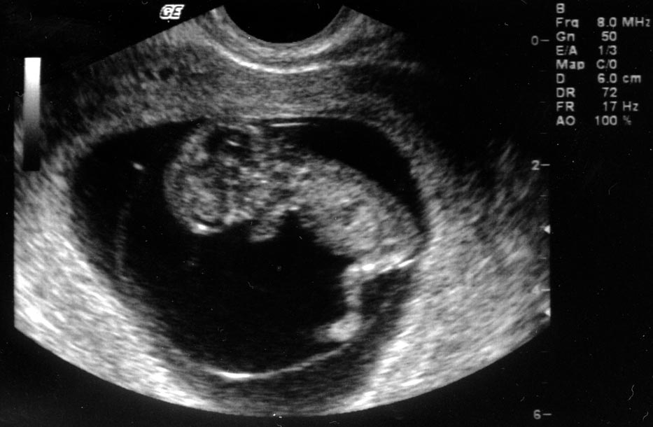
At the hospital, mummy can get an ultrasound scan to see a picture of the baby inside her tummy.
Can you see the baby?

Slide 4
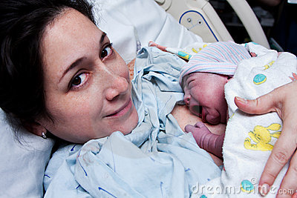
Look! The baby is now out of mummy’s tummy!

Slide 5
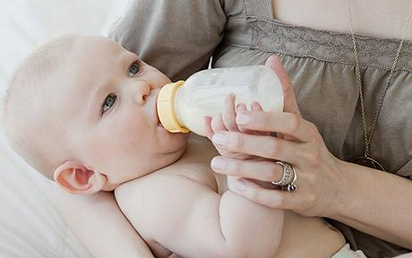
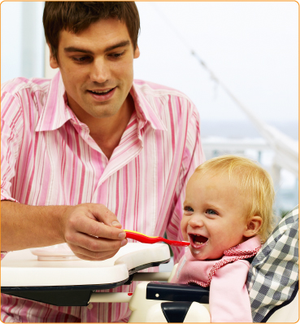
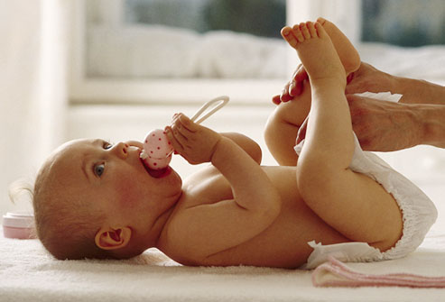
Babies need lots of help. How are the babies’ parents helping them?
Who looked after you when you were a baby?

Slide 6
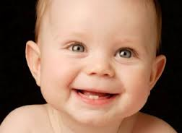
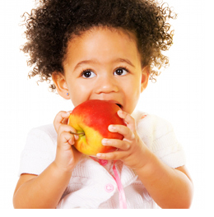
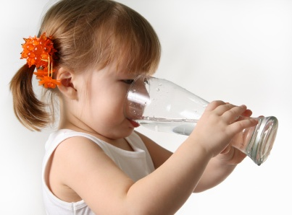
As babies grow, they are able to start doing things themselves, and their bodies change too.

Slide 7
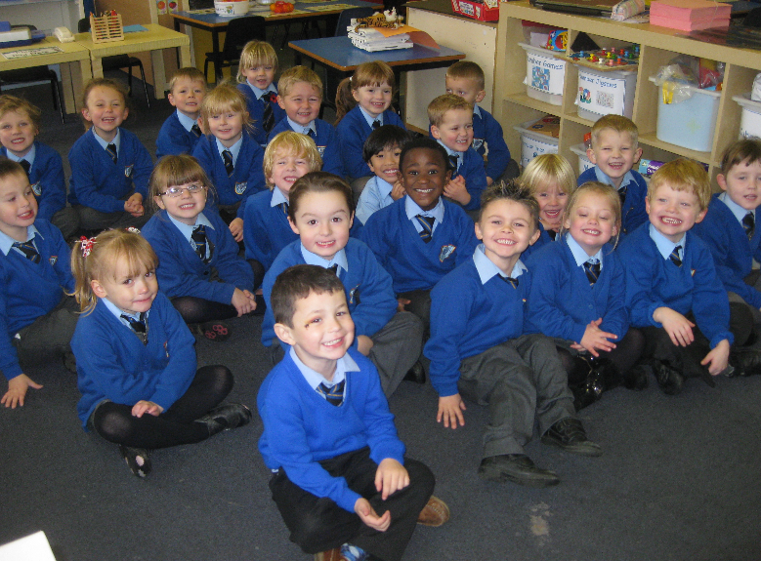
When the babies get a bit older, they can go to school.

Slide 8
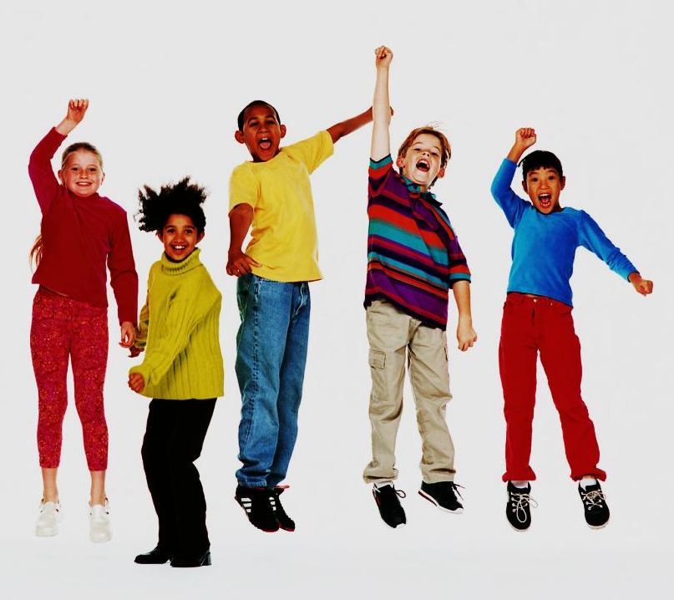
When children are 13 years old, they are called teenagers. During this time, their bodies change a lot.
Teenagers grow into adults.

Slide 9
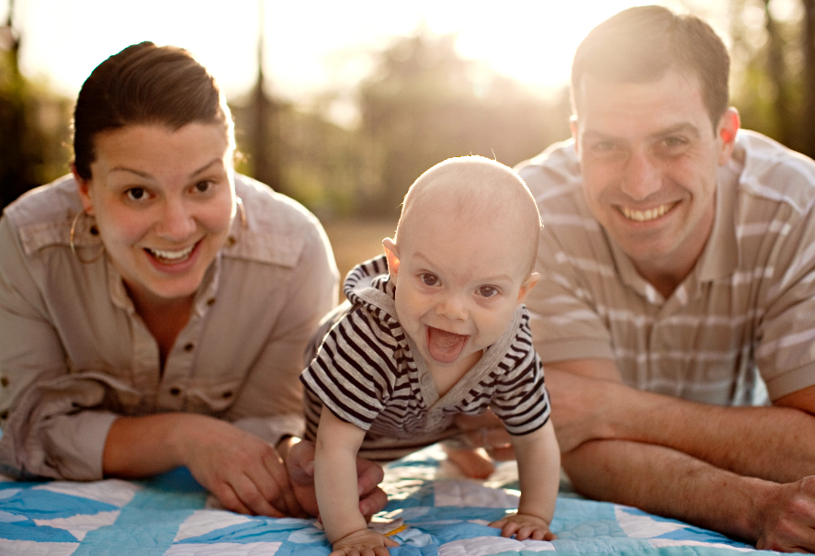
Adults have finished growing. They can have their own babies.

Slide 10
Adults grow older. They must look after their bodies to have a healthy life.

Slide 11
