Slide 1
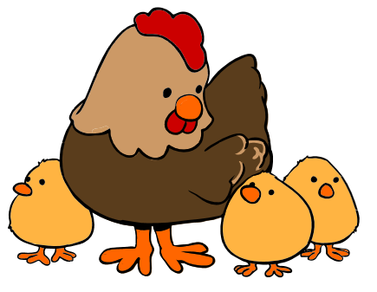
The Life Cycle of a Chicken
Notes:
http://upload.wikimedia.org/wikipedia/commons/6/62/Hen_and_chicks_cartoon_04.svg

Slide 2
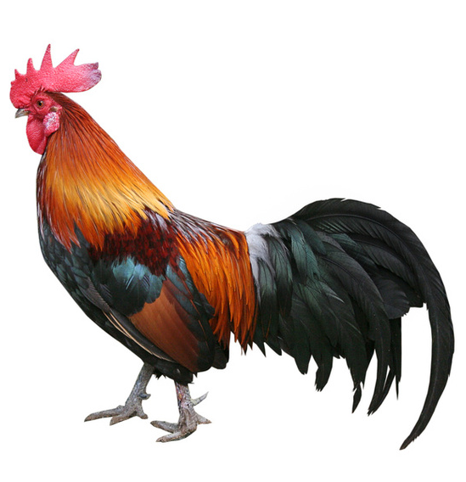
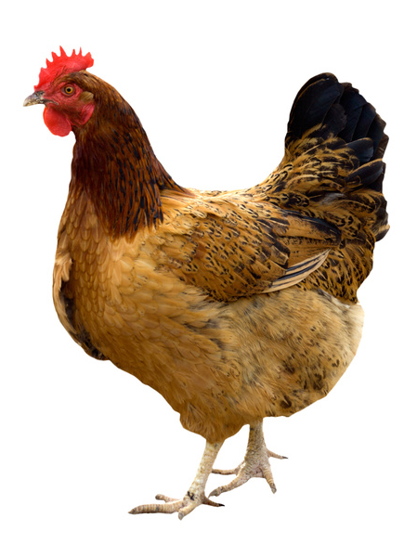
A mummy chicken is called a hen
A daddy chicken is called a rooster
Together they will make a baby chicken.
Notes:
http://www.hen.com/
http://www.chinatownsfbay.com/article/between-a-rooster-and-a-swan-goose/

Slide 3
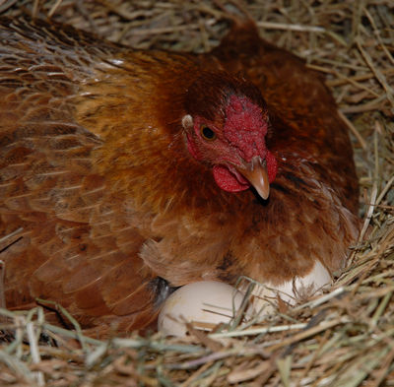
The baby chicken is inside the egg. Can you see the eggs?
The hen sits on her eggs to look after them and keep them warm.
Notes:
http://luckyhensrescuewigan.weebly.com/broody-hen-help-sheet.html

Slide 4
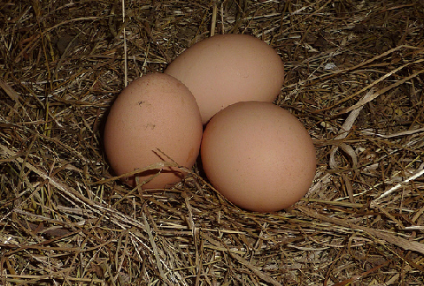
How many eggs are there here?

Slide 5
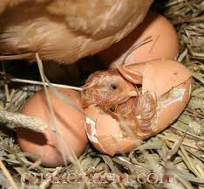
Look! The egg is hatching! What’s inside the egg?

Slide 6
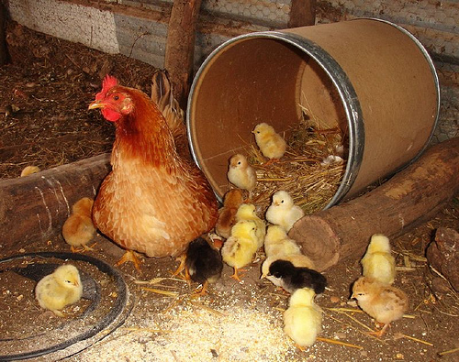
Look at the chicks with their mum!
How many chicks can you see here?
Notes:
http://lafermedesourrou.blogspot.co.uk/2009/03/hen-with-17-chicks.html

Slide 7
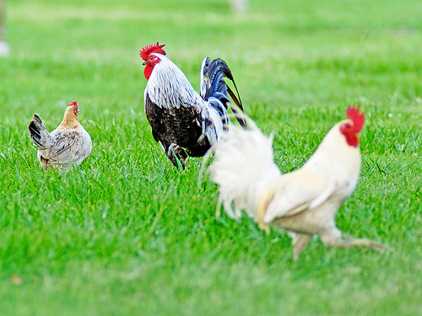
The chicks have now grown up. It’s now their turn to be mummies and daddies.
Notes:
http://leesbird.com/bb/chicken-hens-and-roosters/

Slide 8
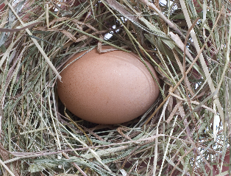
How many eggs can a hen lay a day?
Just 1
Notes:
http://www.hodbin.com/img15386.search.htm

Slide 9
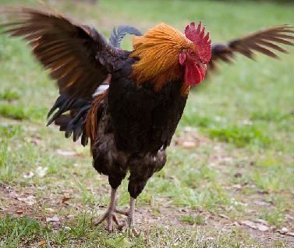
Can chickens fly?
No! But they can jump!
Notes:
http://www.flickr.com/photos/thebigwranch12/galleries/72157624441308070/

