Slide 1
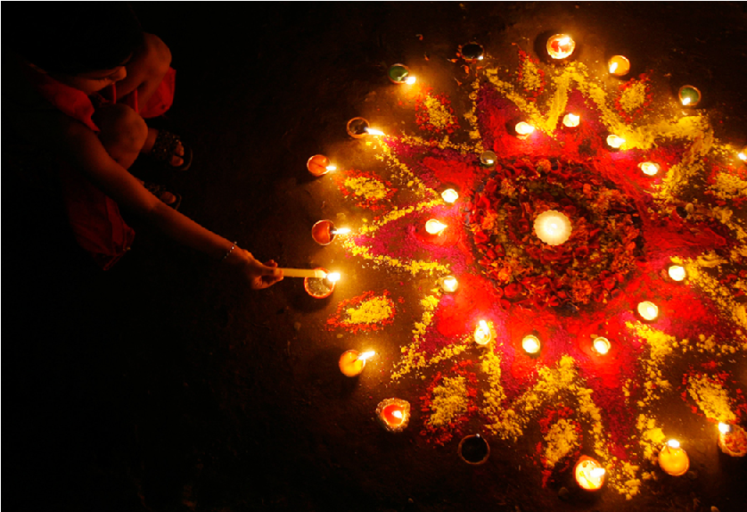
Diwali
Notes:
For video on Diwali: http://www.youtube.com/watch?feature=player_embedded&v=HrrW3rO51ak#!
For Rama and Sita Diwali story, go to : www.teachers.org.uk/files/The-story-of-Rama-and-Sita.ppt
http://www.boston.com/bigpicture/2009/10/diwali_2009.html

Slide 2
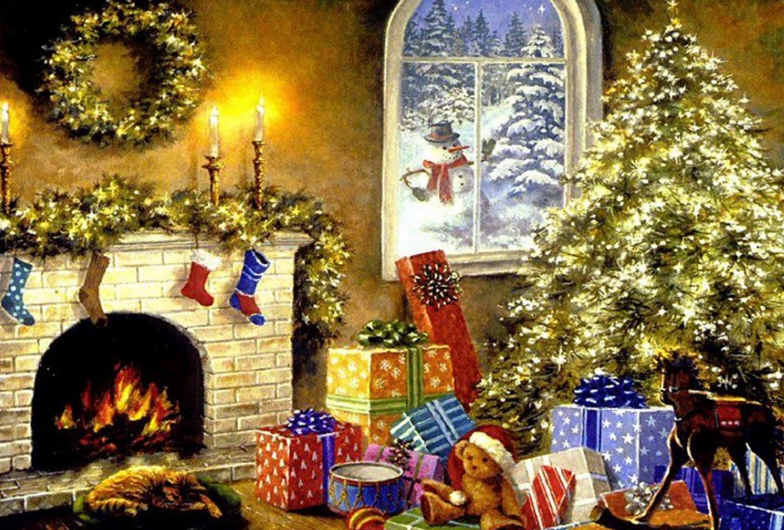
What is a festival?
Diwali is a Hindu festival. A festival is a religious celebration.
Christmas is a Christian celebration.
Notes:
www.crazy-frankenstein.com

Slide 3
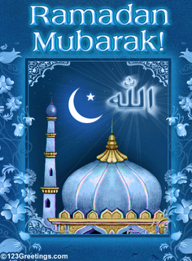
What is a festival?
Ramadan is an Islam celebration.
Notes:
http://theramadanblog.blogspot.co.uk/2010/08/night-before-ramadan.html

Slide 4
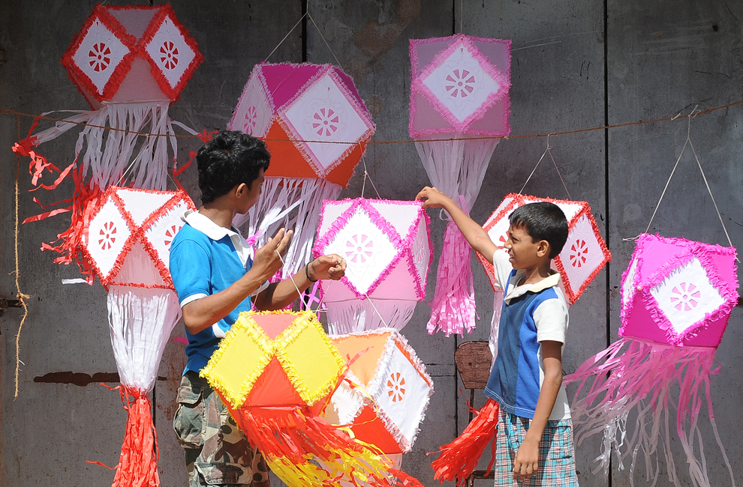
What is a festival?
Vesak is a Buddhist celebration.
Notes:
http://www.boston.com/bigpicture/2011/05/vesak_day_2011.html

Slide 5
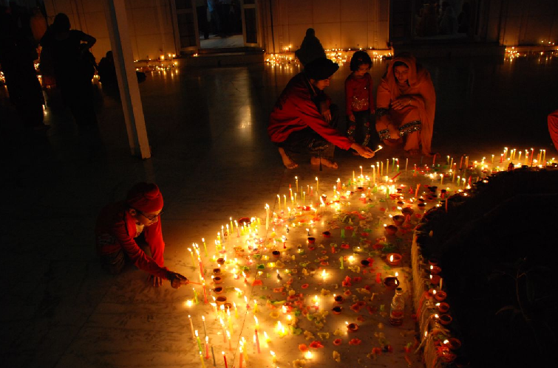
What is a festival?
Diwali is a Hindu celebration. It lasts for 5 days.
Notes:
http://technorati.com/lifestyle/travel/article/diwali-the-festival-of-lights/

Slide 6
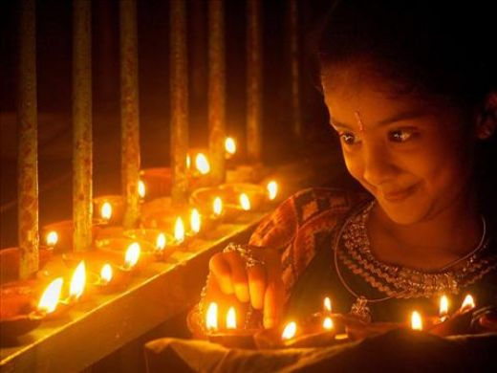
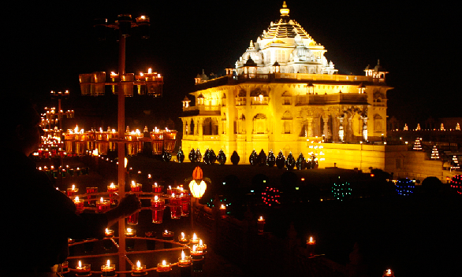
Diwali
Diwali is also known as the festival of lights. This is because people light small oil lamps and put them around their house, shops and street.
Notes:
http://prasadjain.hubpages.com/hub/DIWALI-INDIAN-FESTIVAL-OF-LIGHTS
http://www.boston.com/bigpicture/2009/10/diwali_2009.html

Slide 7
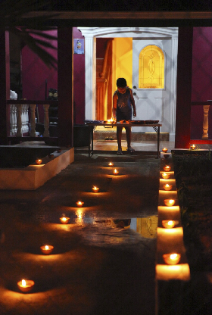
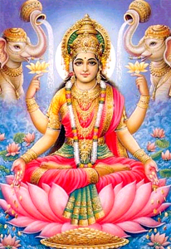
Why light oil lamps and candles?
Diwali is a festival for a Goddess called Lakshmi.
We light candles so that she can find her way into our homes. She will help us become wealthy.
Notes:
http://www.netglimse.com/holidays/diwali/how_to_do_diwali_lakshmi_puja.shtml
http://historiesofthingstocome.blogspot.co.uk/2011/12/hail-winter-solstice-deus-sol-invictus.html

Slide 8
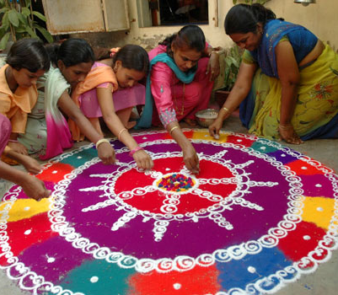
Rangoli patterns
We also make rangoli patterns on the floor so that goddess Lakshmi can see them and come into our homes.
Notes:
http://www.fropper.com/post/38581

Slide 9
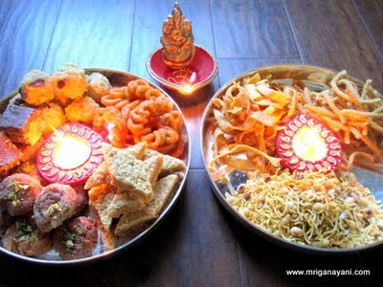
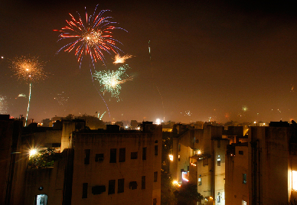
What else happens during Diwali?
People clean their home
People wear new clothes
People share food and gifts with their family and friends
There are firework displays!
Notes:
http://www.loveandlentil.com/2009/10/diwali-has-come-and-gone.html
http://www.boston.com/bigpicture/2009/10/diwali_2009.html

Slide 10
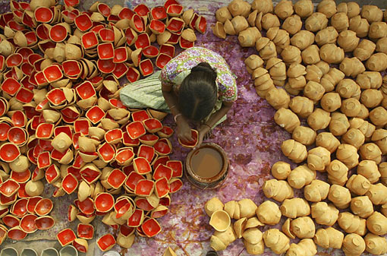
Let’s celebrate Diwali
This lady is making oil lamps. How can we make our own ones?
Notes:
We can make our own ones with clay, plasticine, plastics pots, (papier mache half a blown balloon), fruits and vegetables, etc
http://prasadjain.hubpages.com/hub/DIWALI-INDIAN-FESTIVAL-OF-LIGHTS

Slide 11
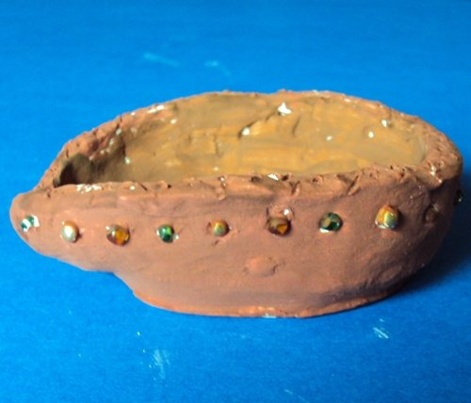
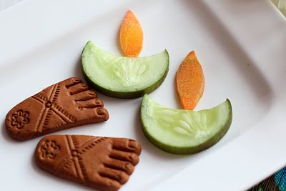
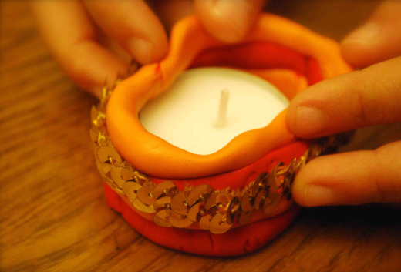
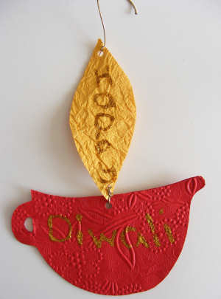
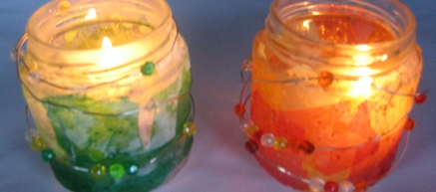
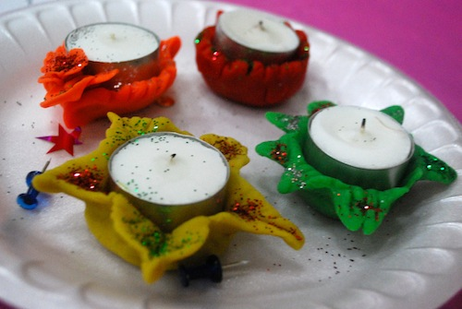
Let’s celebrate Diwali
Notes:
http://www.squidoo.com/easy-crafting-for-kids
http://www.incultureparent.com/2010/10/diwali-lantern/
http://kidworldcitizen.org/2011/11/25/make-a-diya-for-diwali/
http://www.artsycraftsymom.com/2011/10/diwali-craft-ideas-for-kids.html
http://www.activityvillage.co.uk/diya-mobile.htm

