Slide 1
?
+
?
= l0
The
Number
Bonds
Chant
www.TheStorySeed.com
Notes:
Which two numbers add to 10?
Learn this chant and you’ll know them.
(clap, clap, clap, clap)

Slide 2
l
and
9
!
l
9
Notes:
1 and 9, let’s draw a line,
Draw a heart and draw a sign.
1, 9, 1, 9

Slide 3
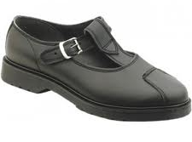
8
and
2
2
8
Notes:
8 and 2, now buckle your shoe,
Tie your hair and dye it blue.
8, 2, 8, 2.

Slide 4
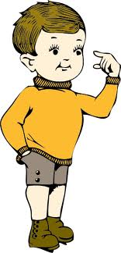
7
and
3
3
7
Notes:
7 and 3, point at a tree,
Point at you and point at me.
7, 3, 7, 3

Slide 5
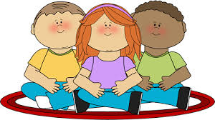
6
and
4
4
6
Notes:
6 and 4, jiggle on the floor,
Wave your arms and wiggle some more.
6, 4, 6, 4.

Slide 6
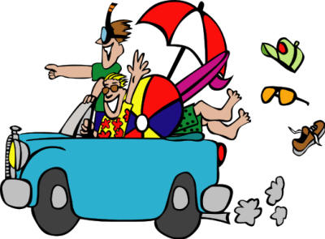
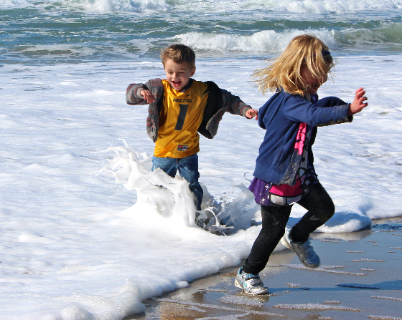
5
and
5
5
5
Notes:
5 and 5, to the beach we drive,
Splash in the water and go for a dive.
5,5,5,5.

Slide 7
?
+
?
= l0
9 and l
8 and 2
7 and 3
6 and 4
5 and 5
Notes:
Now we’ve learnt all the pairs to ten.
That was fun, let’s start again!
(clap, clap, clap, clap)

