Slide 1
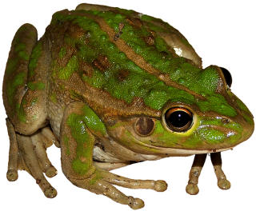
The Life Cycle of a Frog
Notes:
http://www.activityvillage.co.uk/sites/default/files/images/images2/frog_theme_for_kids.jpg

Slide 2
Frogs are amphibians. That means they live in the water when they were young (baby frogs) and then moved out of the water and onto the land when they grow up.
We’re going to follow their journey…

Slide 3
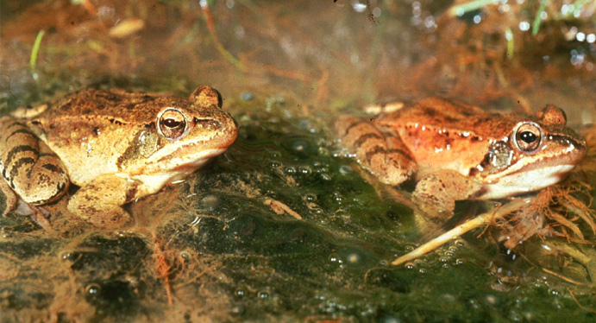
Here’s the mummy and daddy frog. The mummy frog is ready to lay her eggs.
Notes:
http://www.surrey-arg.org.uk/SARG/08000-TheAnimals/SpeciesPages/Agile_Frog/Agile_Frog_Pair.jpg

Slide 4
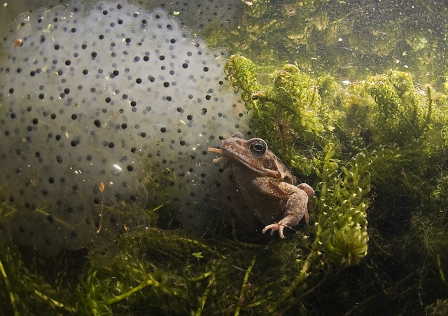
The mummy frog lays her eggs in the water
Notes:
http://laups.org/gallery2/d/3339-2/3rd_coldwater_FrogEggs_Derek_Haslam.jpg

Slide 5
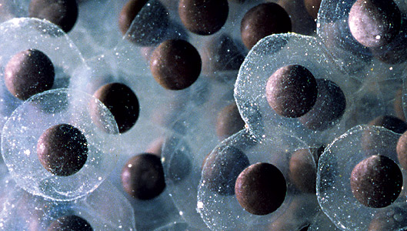
Here are the frog eggs. They are called a spawn. The eggs haven’t hatched yet.
Notes:
http://www.chicagowilderness.org/CW_Archives/issues/summer2008/images/frog_eggs.jpg

Slide 6
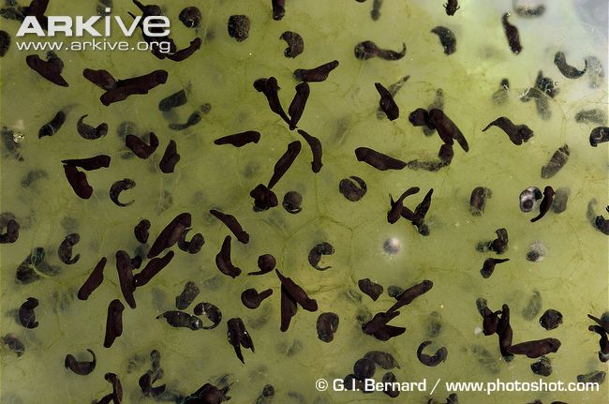
The eggs have hatched! One day these tadpoles will turn into frogs!
Notes:
http://cdn1.arkive.org/media/1B/1BA2B8EE-57D2-4541-9861-2606B153AE3A/Presentation.Large/Common-frog-spawn-and-newly-emerged-tadpoles.jpg

Slide 7
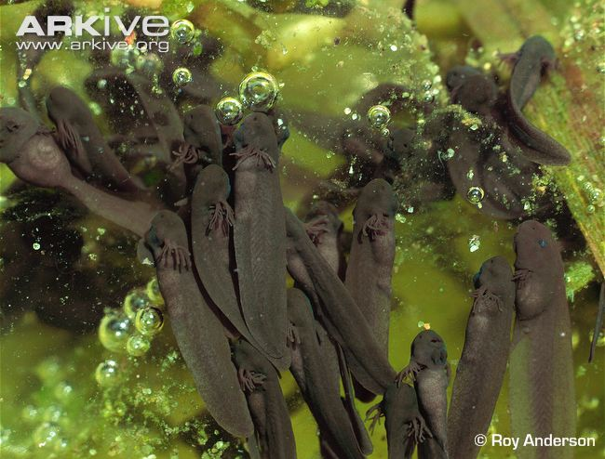
As the tadpoles grow, they develop back legs. Can you see them?
Notes:
http://cdn2.arkive.org/media/E1/E1131D95-9567-4B74-8CBB-955CA2634881/Presentation.Large/Recently-hatched-common-frog-tadpoles.jpg

Slide 8
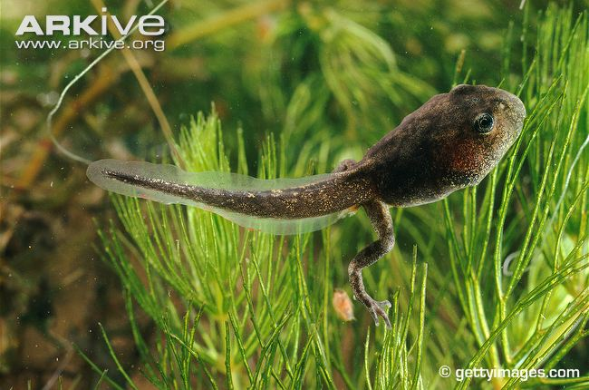
Can you see the back legs on this tadpole?
Notes:
http://cdn2.arkive.org/media/E9/E9496031-4E10-4032-9AB4-41D02BBA6CAA/Presentation.Large/Common-toad-tadpole-with-back-legs.jpg

Slide 9
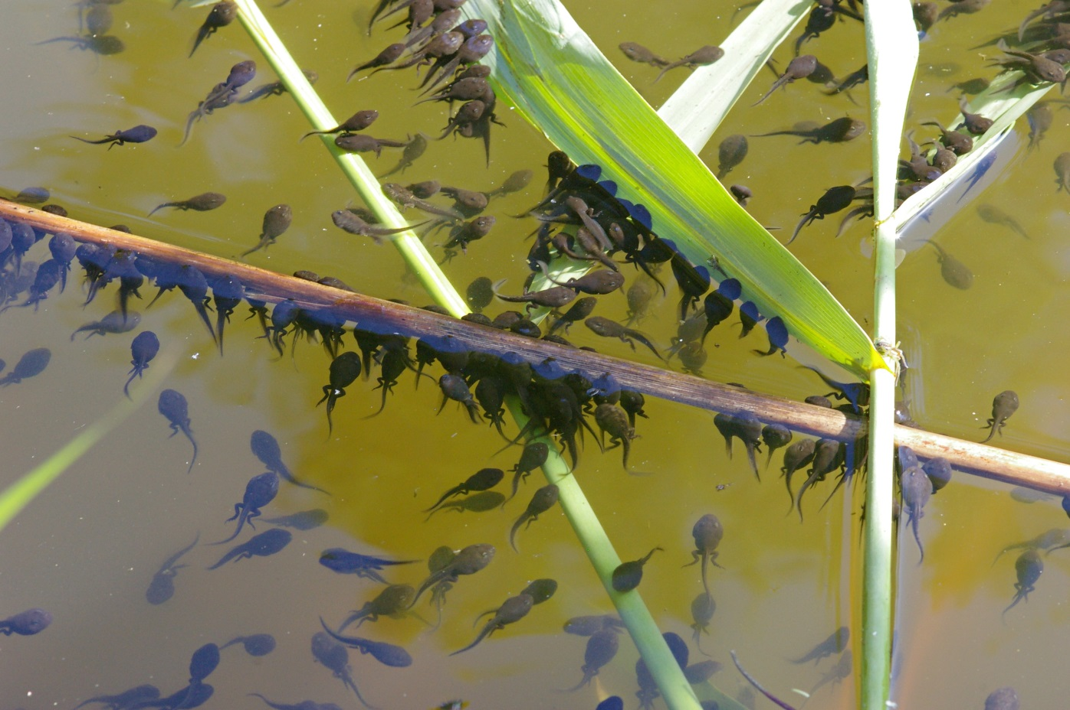
Young tadpoles eat algae. Algae is green and is in the water.
Notes:
http://www.whateats.com/wp-content/uploads/2010/03/Tadpoles-ChristianFischer.jpg

Slide 10
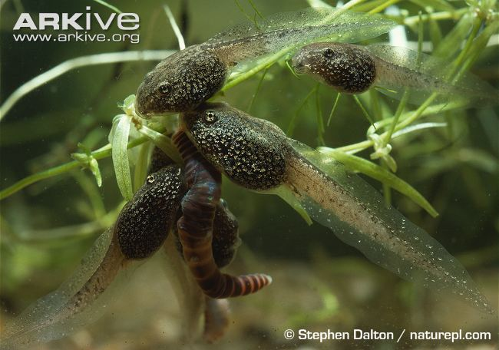
Older tadpoles will eat other things like insects. What are these tadpoles eating?
Notes:
http://cdn1.arkive.org/media/29/29683641-E4E4-45A3-B7AA-44BF86D1A08C/Presentation.Large/Common-frog-tadpoles-feeding-on-worm-in-pond.jpg

Slide 11
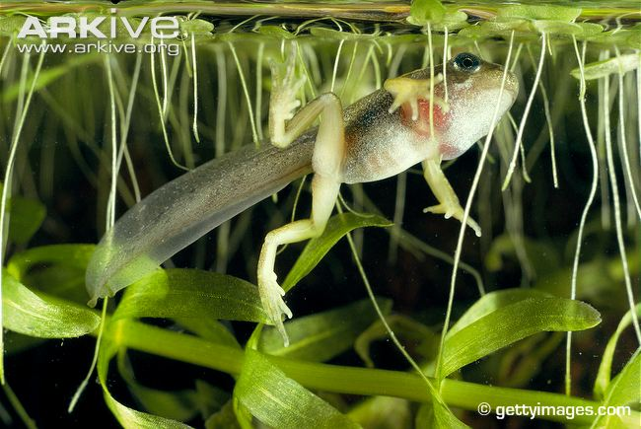
Later, the tadpoles grow front legs.
Notes:
http://cdn2.arkive.org/media/99/99E8CBEE-D793-4D90-8B3C-D68F79864215/Presentation.Large/Common-frog-tadpole-with-front-and-hind-legs.jpg

Slide 12
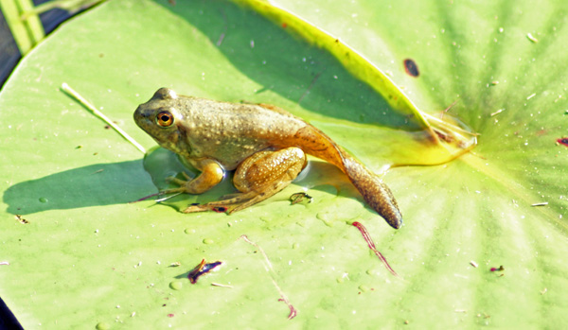
The frogs start to come onto the land.
Notes:
http://naturalmissouri.blogspot.co.uk/2011/07/bullfrog-metamorphosis.html

Slide 13
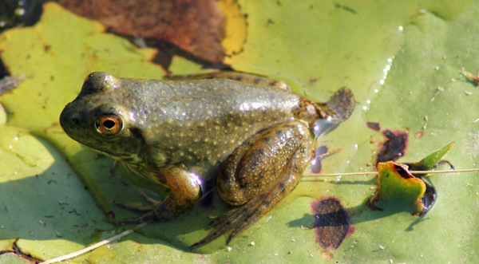
Their tails get shorter and shorter.
Notes:
http://naturalmissouri.blogspot.co.uk/2011/07/bullfrog-metamorphosis.html

Slide 14
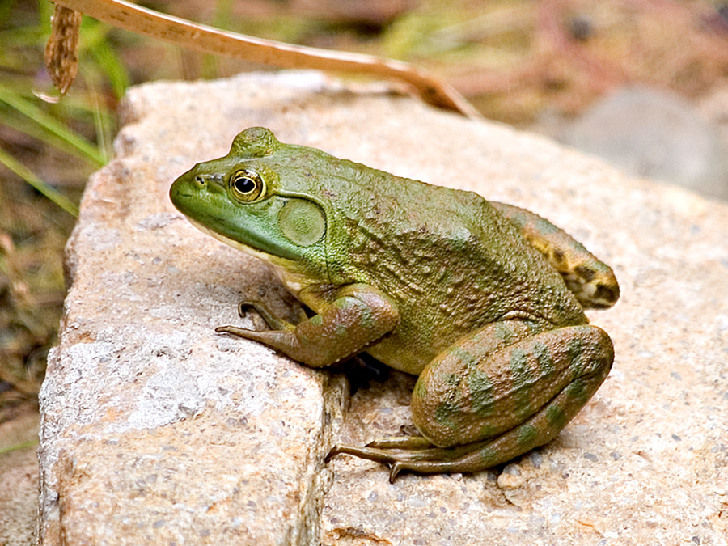
Until you hardly see it.
Notes:
http://ed101.bu.edu/StudentDoc/Archives/ED101sp07/pinatrip/Frog.jpg

Slide 15
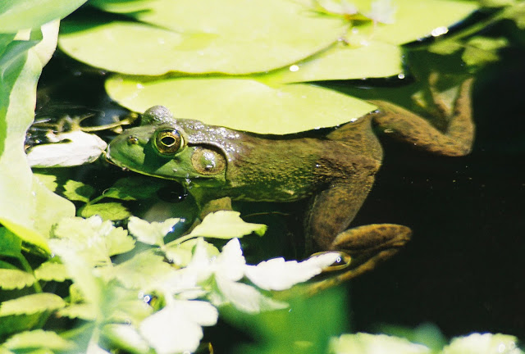
Soon the frogs will have to find another frog so that they can make more frog eggs.
Notes:
http://naturalmissouri.blogspot.co.uk/2011/07/bullfrog-metamorphosis.html

Slide 16
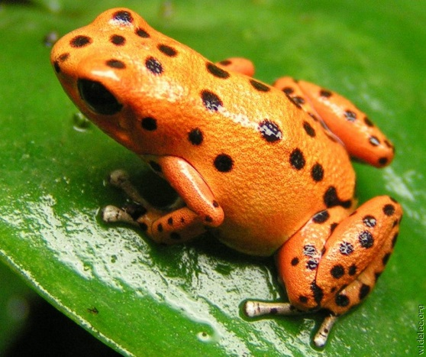
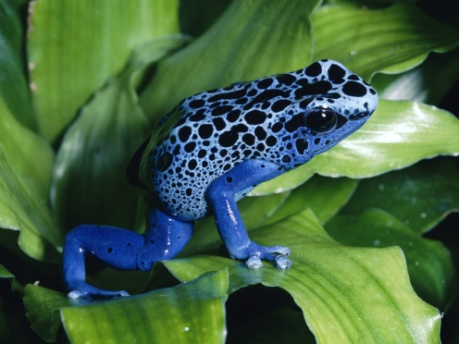
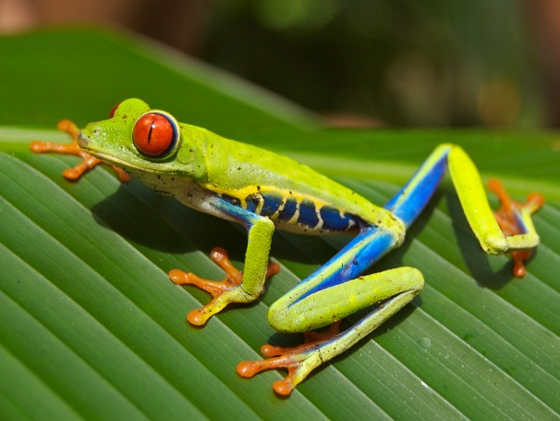
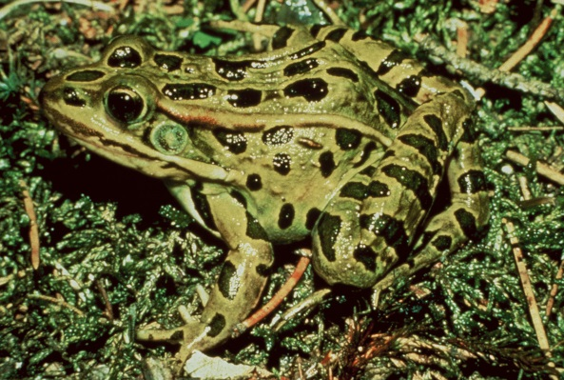
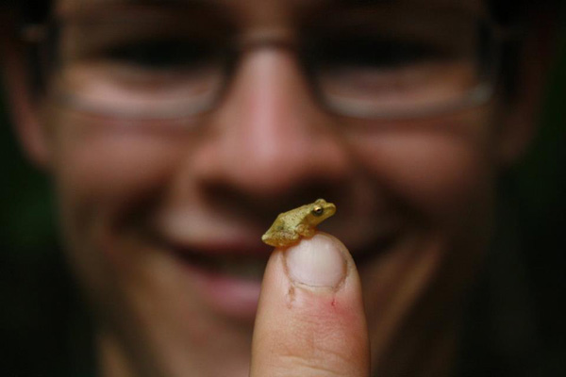
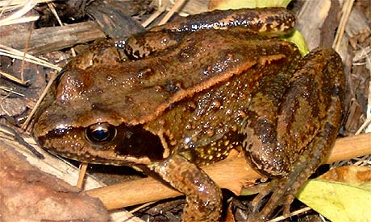
There are lots of different types of frogs. They live in different countries around the world. Some of them have bright colours and some have colours which make them hard to see. Some of them are poisonous.
Notes:
http://upload.wikimedia.org/wikipedia/commons/b/be/Red_eyed_tree_frog_edit2.jpg
http://www.gapyearblog.info/storage/frogs.jpg?__SQUARESPACE_CACHEVERSION=1382437495843
http://3.bp.blogspot.com/-05WciUbGmpI/TuBUGD0rbYI/AAAAAAAADeo/Mg7_u0H3nd0/s1600/Frog-03.jpg
http://www.petsfoto.com/wp-content/uploads/2010/06/Blue-Poison-Dart-Frog2.jpg
http://1.bp.blogspot.com/-0jDY0BbT_3U/T1YkVyGdpXI/AAAAAAAAASE/Vvmmp4LkMM4/s640/red-frog-isla+bastimentos.jpg
http://static.guim.co.uk/sys-images/Environment/Pix/pictures/2008/01/08/commonfrog.jpg
http://frogsaregreen.org/wp-content/uploads/2012/04/Max_and_Crucifer.jpg

Slide 17
Here’s a summary of the life cycle
Notes:
http://upload.wikimedia.org/wikipedia/commons/b/be/Red_eyed_tree_frog_edit2.jpg
http://www.gapyearblog.info/storage/frogs.jpg?__SQUARESPACE_CACHEVERSION=1382437495843
http://3.bp.blogspot.com/-05WciUbGmpI/TuBUGD0rbYI/AAAAAAAADeo/Mg7_u0H3nd0/s1600/Frog-03.jpg
http://www.petsfoto.com/wp-content/uploads/2010/06/Blue-Poison-Dart-Frog2.jpg
http://1.bp.blogspot.com/-0jDY0BbT_3U/T1YkVyGdpXI/AAAAAAAAASE/Vvmmp4LkMM4/s640/red-frog-isla+bastimentos.jpg
http://static.guim.co.uk/sys-images/Environment/Pix/pictures/2008/01/08/commonfrog.jpg
http://frogsaregreen.org/wp-content/uploads/2012/04/Max_and_Crucifer.jpg

