Slide 1
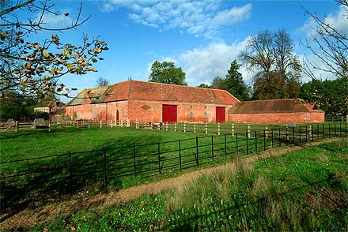
Welcome to the farm!
Notes:
http://www3.hants.gov.uk/countryside/staunton/ornamental-farm.htm

Slide 2
You will need to listen carefully. Which animal is making the sound?
Notes:
www.clker.com/clipart-4337.html

Slide 3
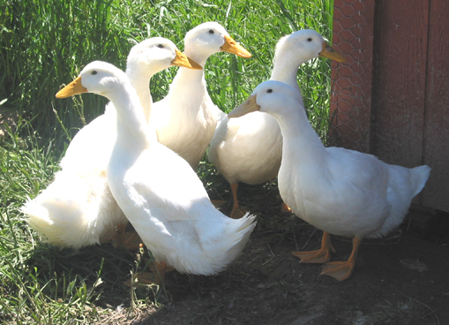
Notes:
http://www.taospaint.com/FarmLife/Ducks.html

Slide 4
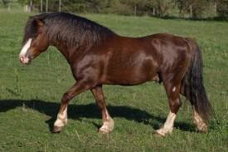
Notes:
http://horse-stables.findthebest.com/l/6930/Orear-Welsh-Pony-Farm

Slide 5
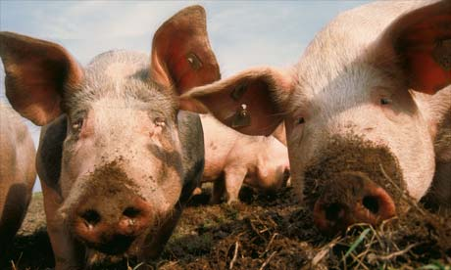
Notes:
http://www.guardian.co.uk/travel/2008/jul/20/familyholidays.green

Slide 6
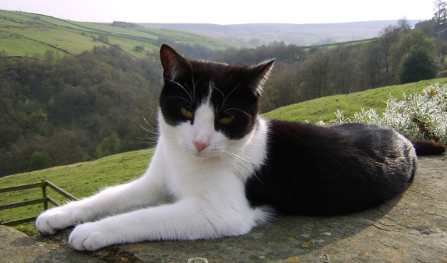
Notes:
http://www.bottomsfarm.co.uk/escape-to-bottoms-farm/

Slide 7
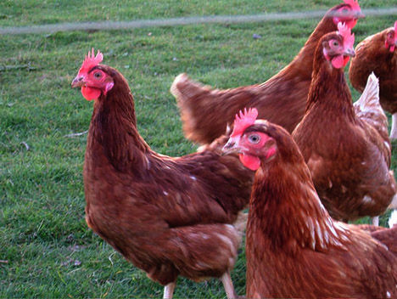
Notes:
http://www.treehugger.com/renewable-energy/chinaatms-first-chicken-waste-biogas-plant-turns-manure-into-electricity-and-heat.html

Slide 8
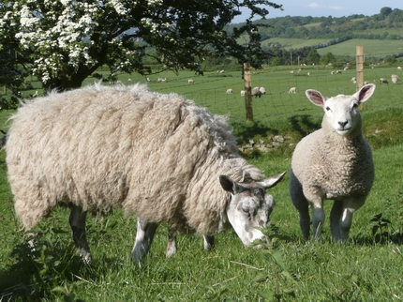
Notes:
http://www.hfstorage.co.uk/abouthillfarm.php

Slide 9
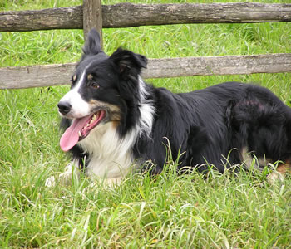
Notes:
http://www.coam.org.uk/ASAnimals/Animals.html

Slide 10
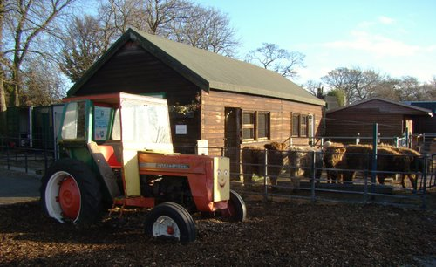
What other sounds might you hear on a farm?
Notes:
http://www.panoramio.com/photo/29615875

